Slide 1
AFTERMATH OF WORLD WAR ONE
U.S. HISTORY

Slide 2
The Treaty of Versailles
June 29, 1919: Treaty of Versailles signed
Main Terms of Treaty:
Germany lost all its colonies
German military limitations
Germany held responsible for the war and made to pay reparations

Slide 3
The Treaty of Versailles
Results of Treaty on the Future:
The financial terms of the reparations kept the German economy broken, and most of the German population hungry
Germany humiliated
- It is because of these harsh conditions that the Nazi Party was able to take power

Slide 4
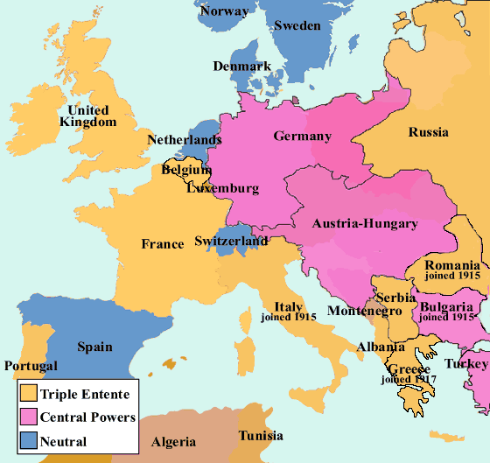
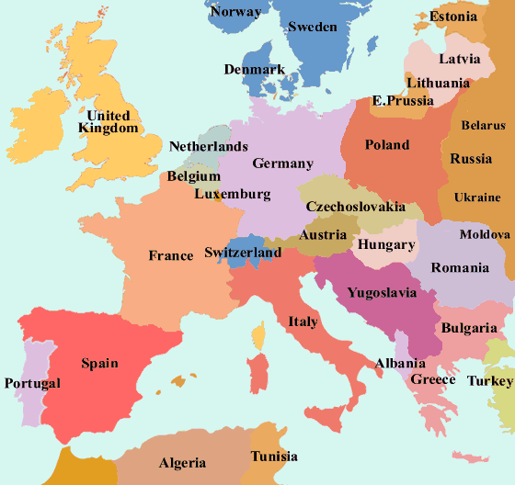
Europe 1914 Europe 1920

Slide 5
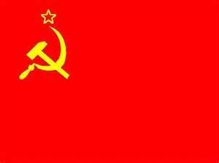
What happened to russia???
1917: Revolution in Russia led by Lenin
This revolution caused the negotiated withdrawal of Russia from the war in 1917
Eventually leads to establishment of the Soviet Union (U.S.S.R.)

Slide 6
Impact on U.S.
In the U.S., problems arose from the return to peace:
-Not enough jobs to support soldiers coming home
-Women who worked during war in factories and offices left their jobs or were fired
- However, the work of women during the war opened opportunities for them later, especially during WW2

Slide 7
Influenza Epidemic
Starts in Europe on Western Front
-Spring 1918; 500,000 Germans afflicted
-Spreads to Allied in Fall 1918; continues through Winter of 1919
-Death rate up to 32%
-Kills more U.S. Soldiers during war than actual combat
Notes:
The strain was unusual for influenza in that this pandemic killed many young adults and otherwise healthy victims - usual influenzas kill mostly newborns, the old, and the infirm.
People without symptoms could be struck suddenly and within hours be too feeble to walk; many died the next day. Symptoms included a blue tint to the face and coughing up blood caused by severe obstruction of the lungs. In later stages, the virus caused an uncontrollable hemorrhaging that filled the lungs, and patients drowned in their body fluids.
In fast-progressing cases, mortality was primarily from pneumonia, by virus-induced consolidation. Slower-progressing cases featured secondary bacterial pneumonias, and there may have been neural involvement that led to psychiatric disorders in a minority of cases. Some deaths resulted from malnourishment and even animal attacks in overwhelmed communities.

Slide 8
Influenza Epidemic
Troops returning to the U.S. spread influenza to civilian population
500,000 Americans killed by virus
By 1920, 30 million people dead worldwide

Slide 9
Casualties of War
Before you view the next slide, remember how I told you to look at the numbers when looking at war casualties. For every casualty, there are all of the friends and family of that person affected by their death or disability. Multiply by at least 20 (that would be just an average approximate guess for close friends and family) to really see the effect.
Notes:
Remains of ammunition
Iron harvest WWI ordnance left beside a field for disposal by the army in 2004 near Ypres in Belgium
Throughout the areas where trenches and fighting lines were located, such as the Champagne region of France, quantities of unexploded shells and other ammunition have remained, some of which remains dangerous and continues to cause injuries and occasional fatalities into the 21st century. Some are still found nowadays, for instance by farmers ploughing their fields and are called the iron harvest. Some of this ammunition contains chemical toxic products such as mustard gas. Cleanup of major battlefields is a continuing task with no end in sight for decades more. Squads remove, defuse or destroy hundreds of tons of unexploded ammunition every year in Belgium and France.
One estimate is that at the current rate, France will not be cleared of unexploded First World War shells for several hundred years.

Slide 10
Country | Dead | Wounded | Missing | Total
United States | 58,480 | 189,955 | 14,290 | 262,725
Australia | 58,150 | 152,170 |  | 210,320
Austria-Hungary | 922,000 | 3,600,000 | 855,283 | 5,377,283
Belgium | 44,000 | 450,000 |  | 494,000
Britain | 658,700 | 2,032,150 | 359,150 | 3,050,000
Bulgaria | 87,500 | 152,390 | 27,029 | 266,919
Canada | 56,500 | 149,700 |  | 206,200
France | 1,359,000 | 4,200,000 | 361,650 | 5,920,650
Germany | 1,600,000 | 4,065,000 | 103,000 | 5,768,000
Greece | 5,000 | 21,000 | 1,000 | 27,000
India | 43,200 | 65,175 | 5,875 | 114,250
Italy | 689,000 | 959,100 |  | 1,648,100
Japan | 300 | 907 | 3 | 1,210
Montenegro | 3,000 | 10,000 | 7,000 | 20,000
New Zealand | 16,130 | 40,750 |  | 56,880
Portugal | 7,222 | 13,751 | 12,318 | 33,291
Romania | 335,706 | 120,000 | 80,000 | 535,706
Russia | 1,700,000 | 5,000,000 |  | 6,700,000
Serbia | 45,000 | 133,148 | 152,958 | 331,106
Turkey | 250,000 | 400,000 |  | 650,000
Totals | 7,938,888 | 21,755,196 | 1,979,556 | 31,673,640

